Slide 1
Tight binding model
Adapted for graphene from Kittel Chapter 9 page 260-263

Slide 2


































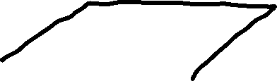






















Slide 3



























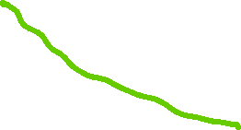



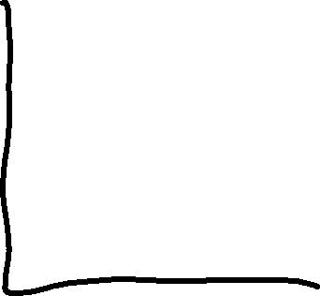


























Slide 4










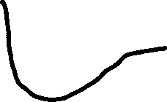





































(or slightly different, TBD)

Slide 5







Proof is in e.g. Ashcroft & Mermin Eq. (10.5)
Bloch condition is ψ(r + r_{j}) = exp(ik.r_{j}) ψ(r). Constant in front of sum is unimportant to this condition and is not included in Ashcroft & Mermin version. Following is from A&M.

Slide 8
i.e. unless m = 0

Slide 9










And hybridization

Slide 11
Now we take into account that graphene has two sublattices, which are not connected by a lattice vector. That independence means that the coefficients b_{n} in the LCAO for atoms on each sublattice can be different.
Then the atoms in the sum over nearest neighbors (for r_{j} not zero) are on the B sublattice

Slide 12
Since the pz level considered is non-degenerate, and the atoms on each sublattice are the same, there is only one term in the LCAO sum, so the coefficients must have unity magnitude and differ only in phase.

Slide 13
This is Eq. (72) from Klemm’s problem solution

Slide 14
We have to consider how this new overlap integral might be different from the previous one.
dr

Slide 16
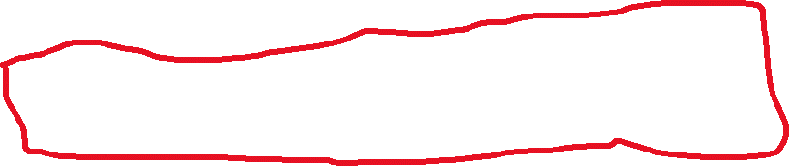
This is Eq. (73) from Klemm’s problem solution

