Slide 1
The equation of motion of a viscous fluid
LL6 section 15

Slide 2























Slide 3




























Slide 4












































Slide 5






























Slide 6



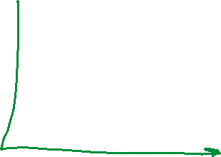






































Slide 7

































Slide 8








































Slide 9


















































Slide 10




















Slide 11





























Slide 12





















Slide 13







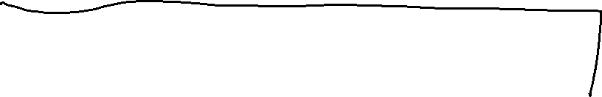
















Slide 14




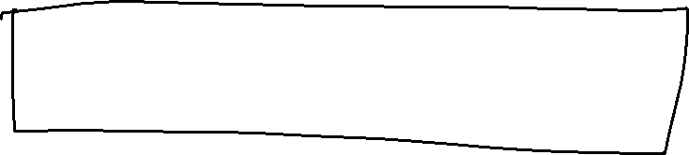






Slide 15





























Slide 16
















Slide 17




























Slide 18

































Slide 19















Slide 20

















































Slide 21





























Slide 22

















































Slide 23








































