Slide 1
Elementary Fluids

Slide 2



Slide 3



Slide 4






Slide 5

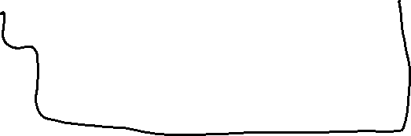

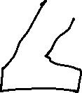



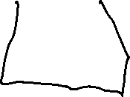
Pressure does not depend on the shape of the fluid’s container, only on depth.
Fluid rises to the same level in each of the open tubes.
Pressure is the same at A as at B. Otherwise fluid would flow one side to the other.

Slide 6



Pascal’s Principle

Slide 7












Slide 8








Proof of Archimedes principle

Slide 9

















Slide 10










Slide 11


































Slide 12










Slide 13







Slide 14




































Slide 15
























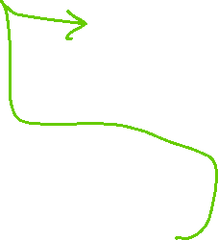



































Slide 16
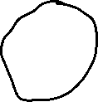
































Slide 17

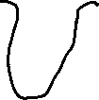






































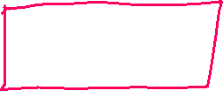



Slide 18






Slide 19




Slide 21











Closer streamlines means faster flow

Slide 22

















Infinitesimal segments are horizontal: No work is done against gravity, only against pressure force.

Slide 23








Total work done on the fluid
Infinitesimal volume of fluid at low height is replaced by an equal volume of fluid at greater height
Speed of fluid in these two volumes is also different

Slide 25













Slide 26




Slide 27















Slide 28











Slide 29



























