Slide 1
Flow with Small Reynolds Number
LL6 section 20

Slide 2









































Slide 3


































Slide 4
















Slide 5












































































Slide 6





























Slide 7























































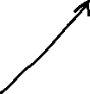




Slide 8
















Slide 9




































Slide 10


























Slide 11















Slide 12






























Slide 13



















Slide 14













Slide 15












Slide 16
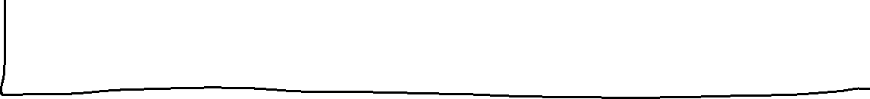
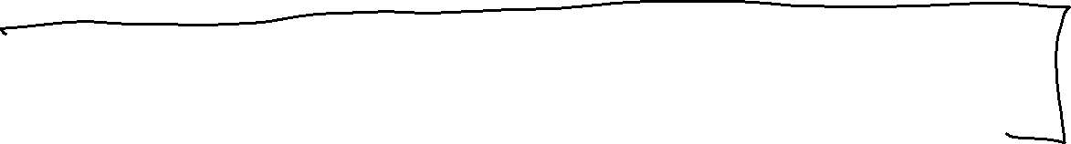






Slide 17













































Slide 18































Notes:
D

Slide 19











Slide 20



























Slide 21

















