Slide 1
The laminar boundary layer
LL6 section 39

Slide 2











































Slide 3




















































Slide 4



































Slide 5







































Slide 6

































Slide 7
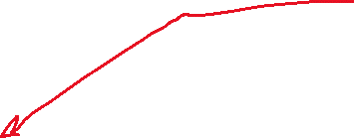























Slide 8

















































Slide 9





























































Slide 10









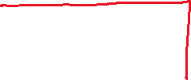












Slide 11








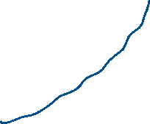







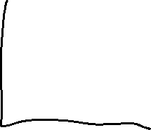



Slide 12









































Slide 13

























Slide 14













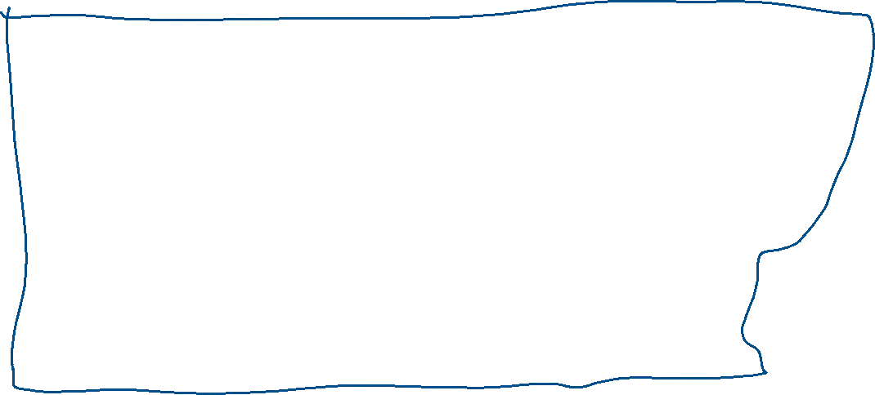









Slide 15






























Slide 16




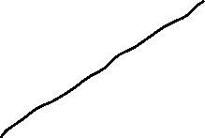
































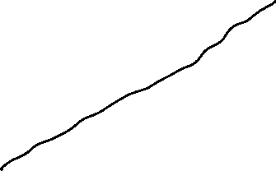




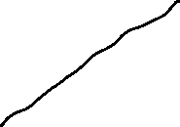







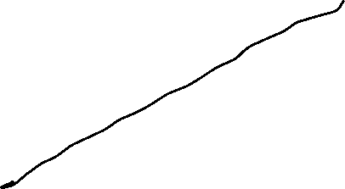



Slide 17
















































Slide 18
















































Slide 19


































































Slide 20























Slide 21










































