Slide 1
Shape & Flow
Chapter 7

Slide 2































Slide 3
















Slide 4














Slide 6
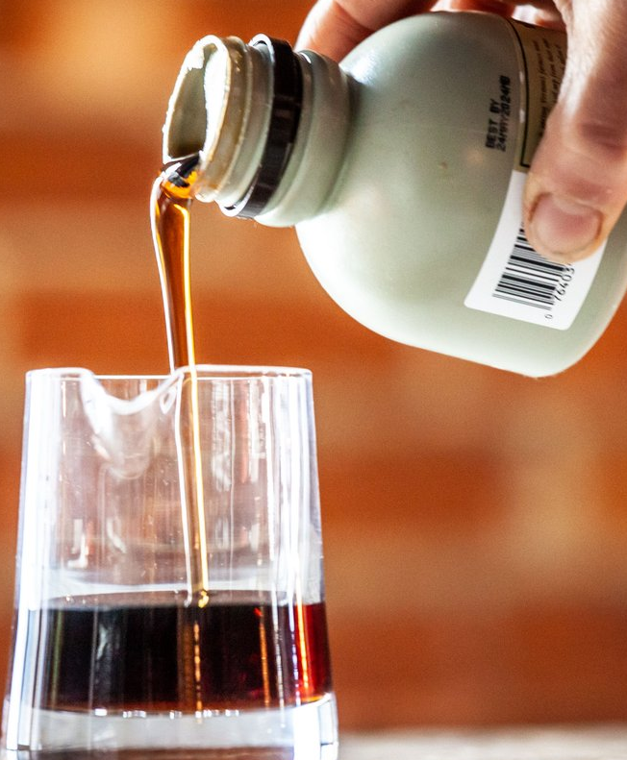




























Slide 7








Slide 8






Slide 9






























