Slide 1
Applications of plasma physics
Chen 1.7

Slide 2














































Slide 3


























mercury rectifiers, hydrogen thyratrons, ignitrons, spark
gaps, welding arcs, neon and fluorescent lights, and lightning discharges

Slide 4
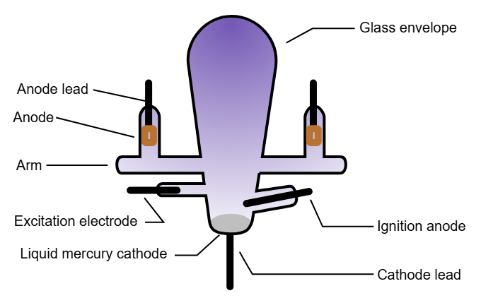
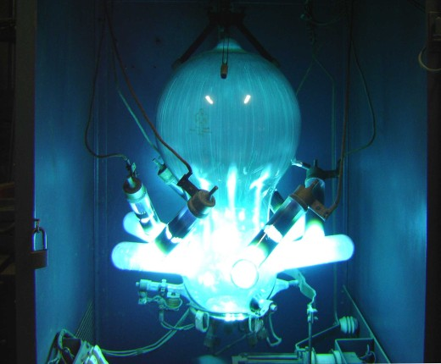
Mercury rectifier
Passes current in one direction only

Slide 5
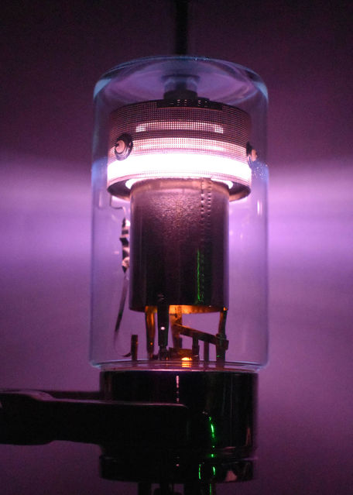
Hydrogen thyratron
Superfast high-current switch

Slide 6
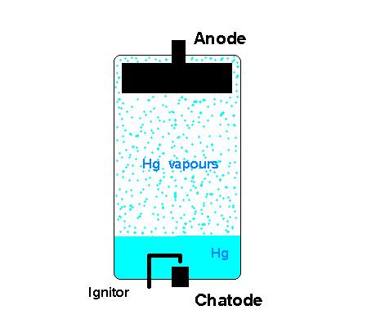
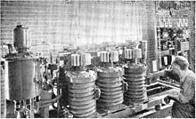
An ignitron is a type of mercury-containing rectifier tube that uses a special electrode to initiate and maintain an arc at the beginning of each electrical cycle, allowing the tube to rectify (convert AC to DC). It's essentially a controlled rectifier, meaning it can be turned on and off by an external signal.

Slide 7
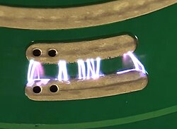
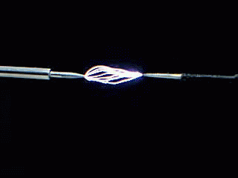
Spark gaps were used historically in early electrical equipment, such as spark gap radio transmitters, electrostatic machines, and X-ray machines. Their most widespread use today is in spark plugs to ignite the fuel in internal combustion engines, but they are also used in lightning arresters and other devices to protect electrical equipment from high-voltage transients.

Slide 8
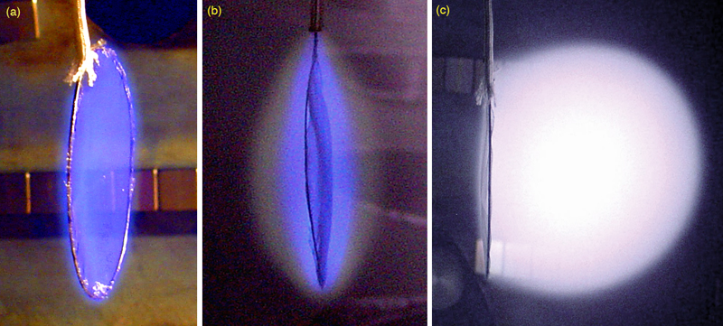
Plasma sheath can be visualized

Slide 9
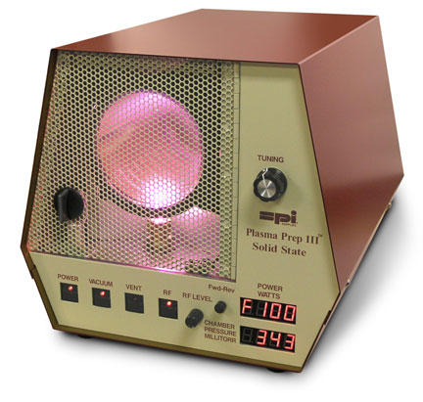
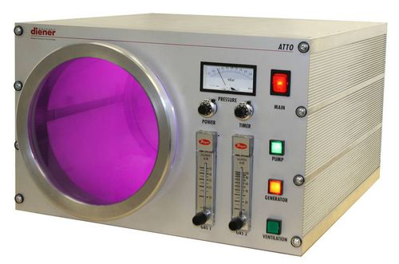
Chips for computers and the ubiquitous handheld devices cannot be made without plasmas. Usually driven by radiofrequency power, partially ionized plasmas (gas discharges) are used for etching and deposition in the manufacture of semiconductors.

Slide 10





























Slide 11
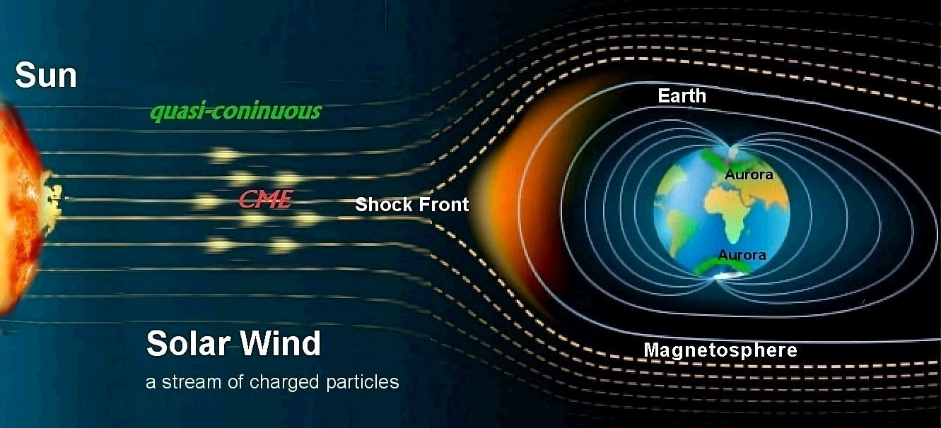












Slide 12
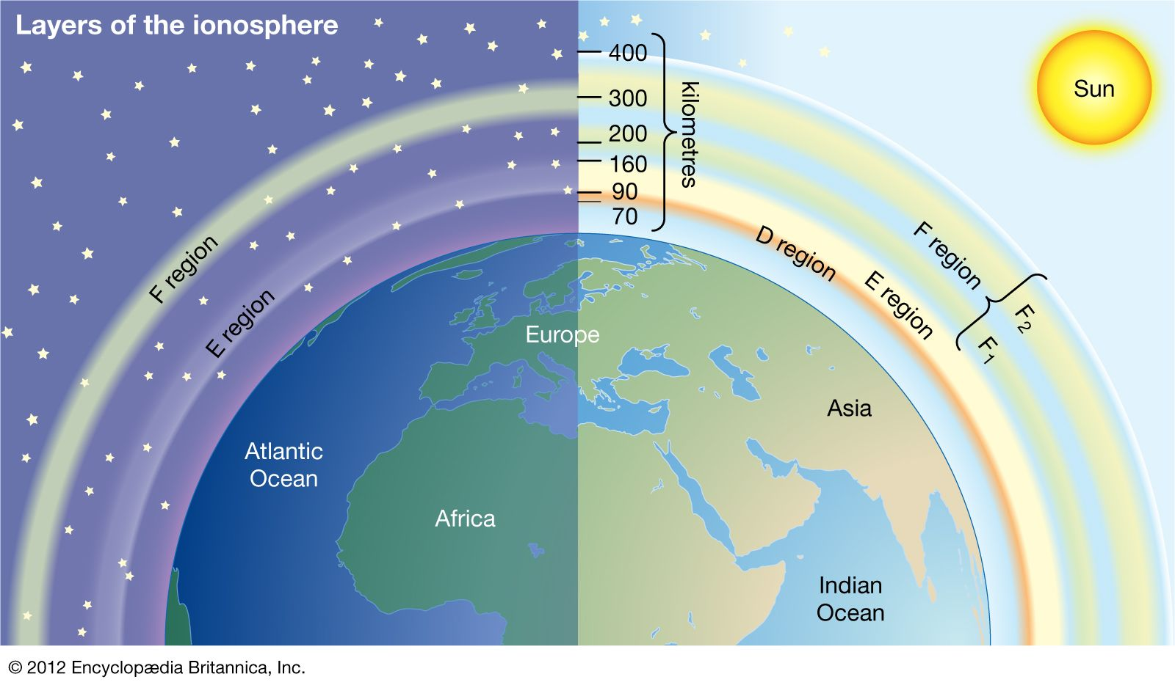
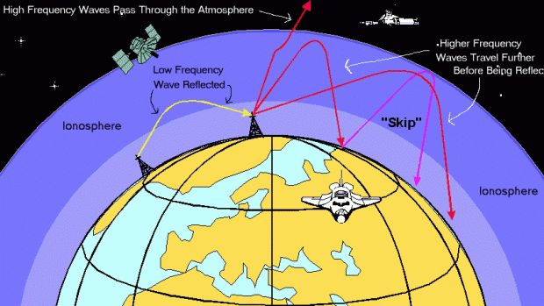



Slide 13
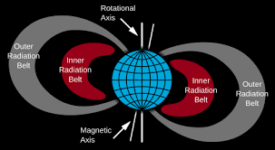




























Slide 14


































Slide 15
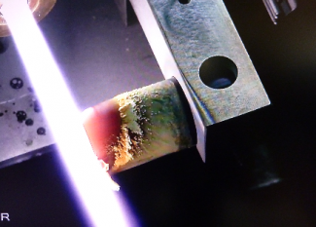











Slide 16
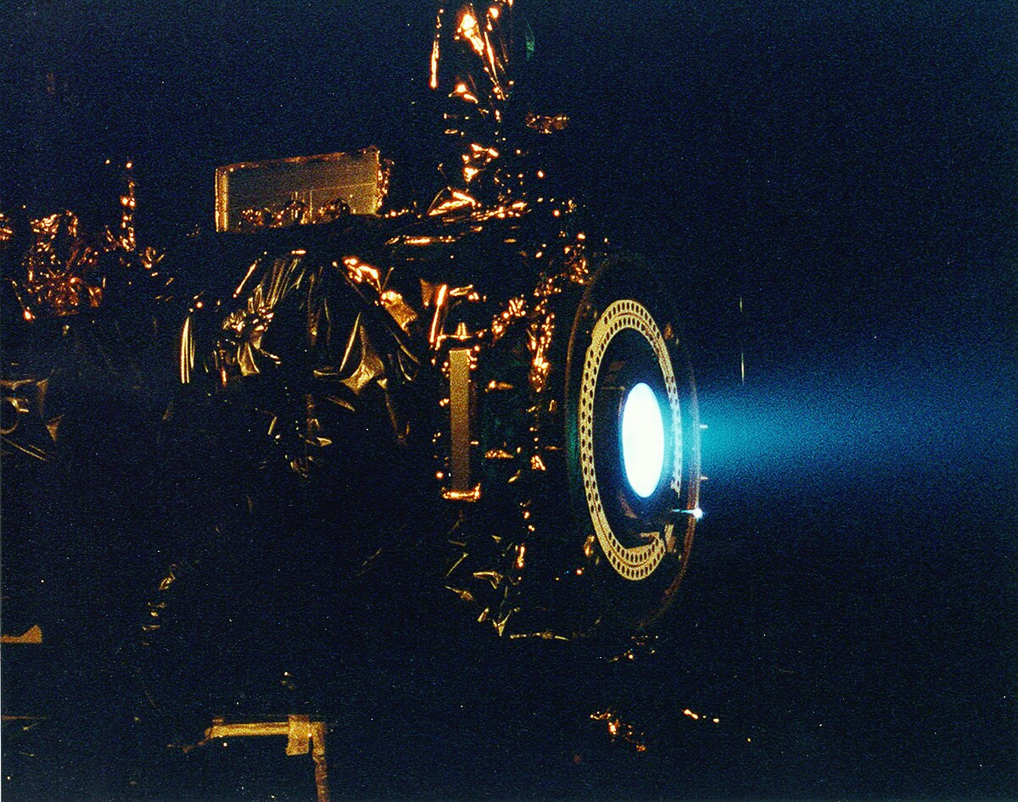



Slide 17









































Slide 18
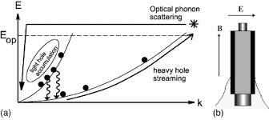
P-Ge laser. Application of solid-state hole plasma in ExB fields

Slide 19
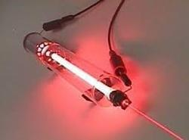






Slide 20
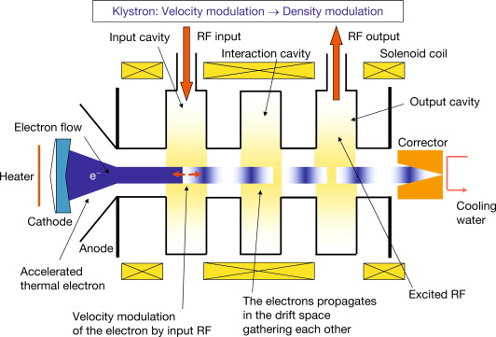





Slide 21
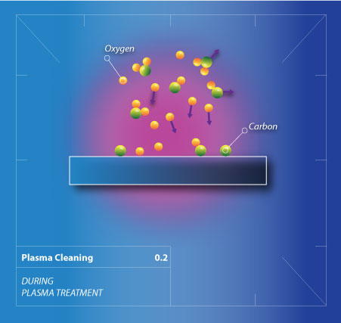
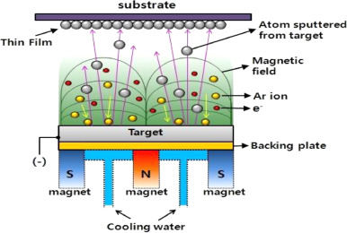







Slide 22
