Slide 1
Plasma 4
Chen 2.1-2.2
Uniform constant E & B

Slide 2























Slide 3
























Slide 4














Slide 5

























Slide 6



























Slide 7


Slide 8






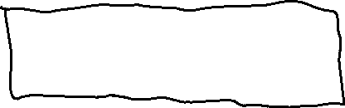



Slide 9











































Slide 10




































Slide 11



















Slide 12











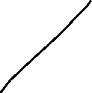







Slide 13












Slide 14














Slide 15
































Slide 16






































Slide 17

























Slide 18





Slide 19
















Slide 20

















Slide 21




















































Slide 22























Slide 23



















