Slide 1
Plasma 5
Chen 2.2.3-2.3.3
Drift due to gravity, grad B, curved B

Slide 2































Slide 3




























Slide 4




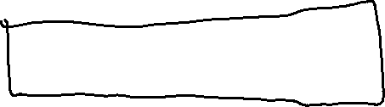







Slide 5


























Slide 6



























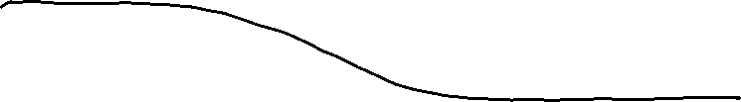



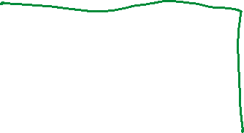



Slide 7
































Slide 8























Slide 9























Slide 10
















Slide 11







Slide 12















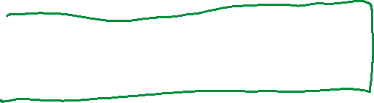




Slide 13


















Slide 14
























Slide 15








































Slide 16




















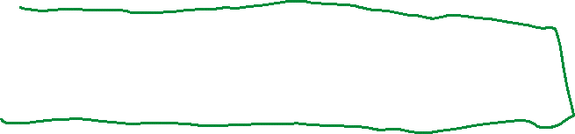












Slide 17






















Slide 18

















Slide 19














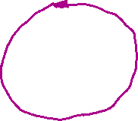





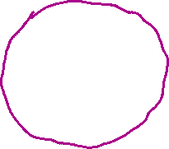



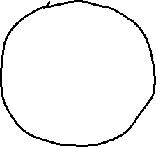


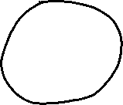





Slide 20

















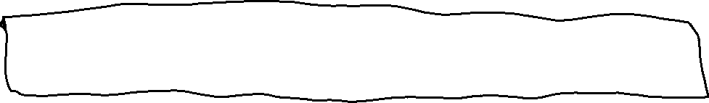




Slide 21































