Slide 1
Plasma 6
Chen 2.3.3
Magnetic mirrors

Slide 2











Notes:
F

Slide 3
























Slide 4








Slide 5


























Slide 6


































































Slide 7















Slide 8



















Slide 9






















Slide 10

































Slide 11




















Slide 12








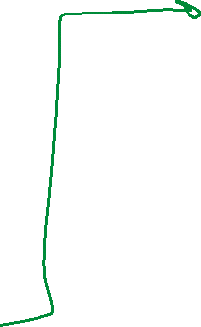























Slide 13





























Slide 14





































Slide 15


















Slide 16

















Slide 17


































Slide 18



































Slide 19


































Slide 20
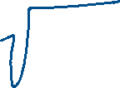


































Slide 21








































