Slide 1
Plasma 7
Chen 2.4
Non-uniform E

Slide 2


































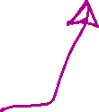









Slide 3
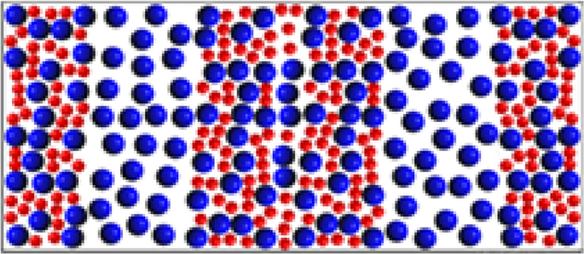






















Slide 4

















Slide 5


Slide 6

















Slide 7



































Slide 8






























Slide 9












Slide 10






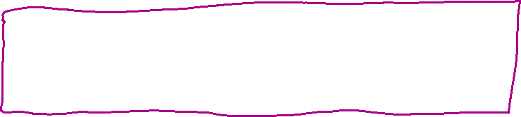













Slide 11











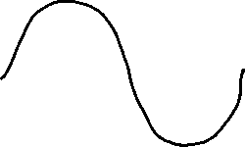

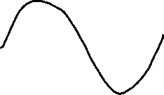





Slide 12












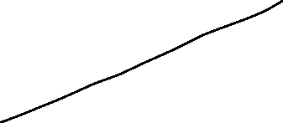



















Slide 13




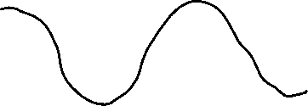











Slide 14


































Slide 15


































Slide 16



































Slide 17



