Slide 1
Plasma 10
Chen 3.1, 3.2, 3.3

Slide 2





















































Slide 3





























Slide 4





















































Electrodynamics of continuous media.
Fields are macroscopic fields, which means the vacuum microscopic fields averaged over molecular dimensions.

Slide 5






















Slide 6



























Slide 7










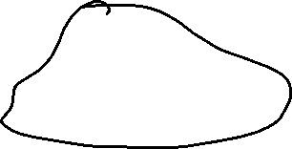



























Slide 8
























Slide 9




















































Slide 10






































Slide 11


















Slide 12































Slide 13



















