Slide 1
Plasma 11
Chen 3.3.1 The convective derivative
Chen 3.3.2 The stress tensor

Slide 2
















































Slide 3










































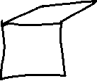




Slide 4



































Slide 5













































Slide 6

















Slide 7





































































Slide 8






































Slide 9


















































Slide 10


































Slide 11




















Slide 12



















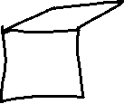














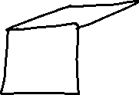

Slide 13
































Slide 14



















































Slide 15






























Slide 16




























Slide 17



























Slide 18








Slide 19














Slide 20




















































Slide 21



















Slide 22






















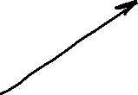




















Slide 23













































Slide 24



























Slide 25











































Slide 26











