Slide 1
Plasma 12
Chen 3.3.3 Collisions
3.3.4 comparison with hydrodynamics
3.3.5 Equation of Continuity
3.3.6 Equation of State
3.3.7 Complete set of fluid equations

Slide 2


























































Slide 3





























































Slide 4























































Slide 5


















































Slide 6

























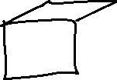



















Slide 7



































Slide 8






























Slide 9












Slide 10





















Slide 11





















Slide 12




























Slide 13































