Slide 1
Plasma 8
Chen 2.5
Time-varying E
Time-varying B

Slide 2



























Slide 3













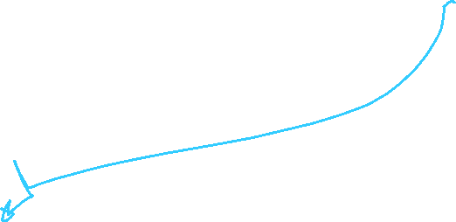










Slide 4











Slide 5












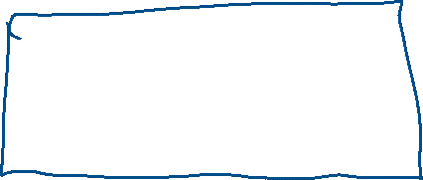










Slide 6








































Slide 7











Slide 8


Slide 9


























Slide 10





































Slide 11























Slide 12
























Slide 13
















Slide 14






















Slide 15



































Slide 16










Slide 17

























Slide 18





























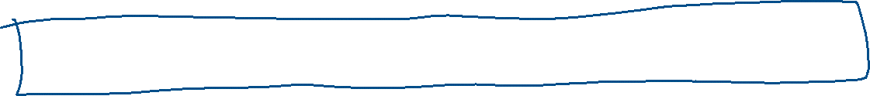

Slide 19
































































Slide 20
