Slide 1
Plasma 9
Chen 2.8 adiabatic invariants

Slide 2















Slide 3































Slide 4



















Slide 5






























Slide 6




































Slide 7

























Slide 8


































Slide 9
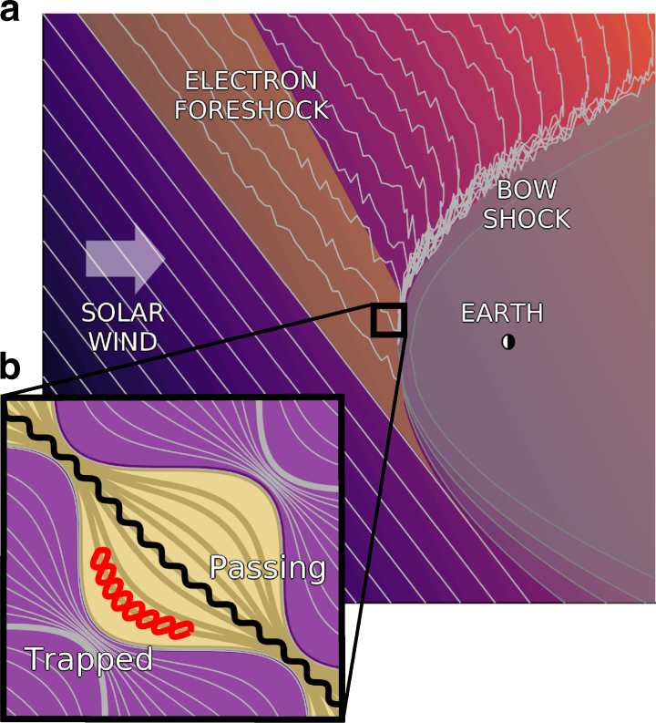
Magnetic pumping model for energizing superthermal particles applied to observations of the Earth's bow shock
E. Lichko & J. Egedal
Nature Communications volume 11, Article number: 2942 (2020)

Slide 10




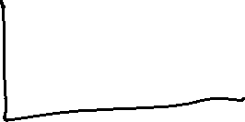




































Slide 11
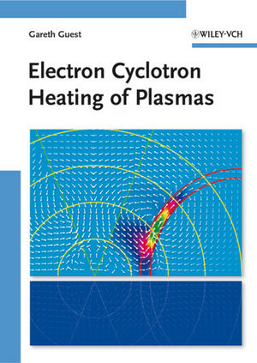
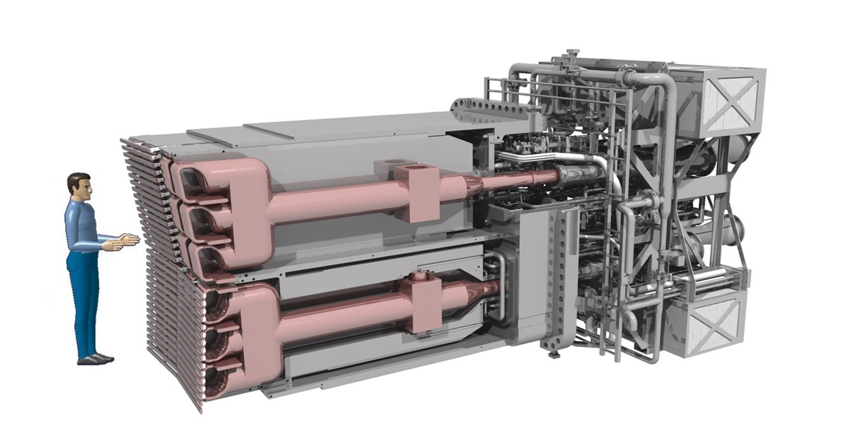
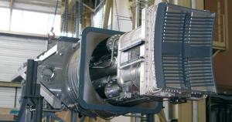
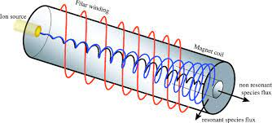
How to pump 20 MW of power into 1 gram of plasma

Slide 12











































Slide 13


































Slide 14
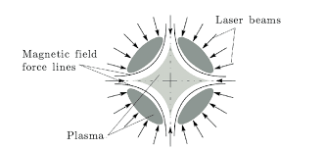
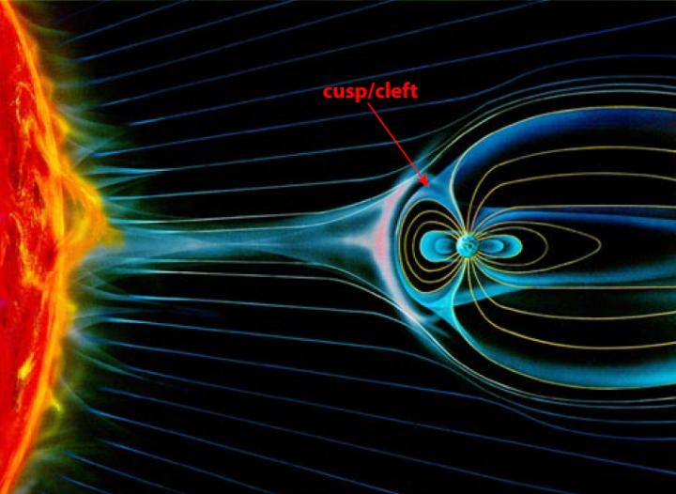

Slide 15









































Slide 16












































Slide 17


















































Slide 18



































Slide 19



































Slide 20




















Slide 21

































Slide 22






Slide 23















Slide 24















































Slide 25




























Slide 26



















