Slide 1
Plasma 15
4.1 Representation of waves
4.2 Group velocity
4.3 Plasma oscillations

Slide 2














































Slide 3






















Slide 4

























Slide 5







































Slide 6























Slide 7






































Slide 8




























Slide 9











Slide 10






















Slide 11
























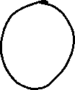


















Slide 12


























































Slide 13




















Slide 14





























Slide 15

































Slide 16












Slide 17




























Slide 18
















Slide 19








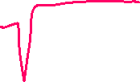




Slide 20













Slide 21













Slide 22



























