Slide 1
Plasma 16
Chen 4.4 Electron plasma waves

Slide 2









































Slide 3



















Slide 4








Slide 5
















Slide 6












Slide 7











Slide 8




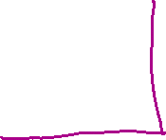

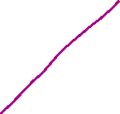















Slide 9





























Slide 10
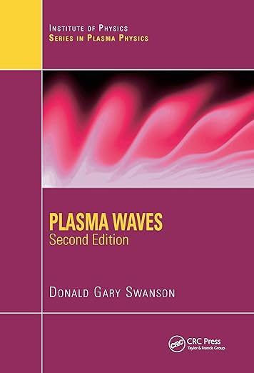


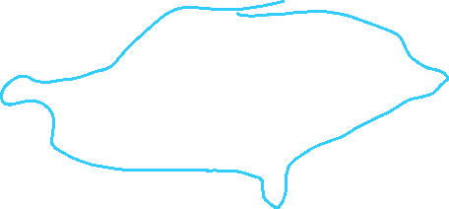






















https://www.youtube.com/watch?v=RCi5rOy0Xnc

Slide 11



















Slide 12

























Fig. 4.7 Square of the
observed frequency
vs. plasma density, which
is generally proportional
to the discharge current.
The inset shows the
observed spatial distribution
of oscillation intensity,
indicating the existence
of a different standing wave
pattern for each of the
groups of experimental
points. [From D. H. Looney
and S. C. Brown, Phys. Rev.
93, 965 (1954).]

Slide 13


Fig. 4.8 Schematic of an experiment to measure plasma waves.
[From P. J. Barrett, H. G. Jones, and R. N. Franklin, Plasma Physics 10, 911 (1968).]
The cylindrical column of quiescent plasma is produced in a Q-machine by thermal ionization of Cs atoms on hot tungsten plates (not shown). A strong magnetic field restricts electrons to motions along the column. The waves are excited by a wire probe driven by an oscillator and are detected by a second, movable probe. A metal shield surrounding the plasma prevents communication between the probes by ordinary microwave (electromagnetic wave) propagation,
since the shield constitutes a waveguide beyond cutoff for the frequency used. The traveling waveforms are traced by interferometry: the transmitted and received signals are detected by a crystal which gives a large dc output when the
signals are in phase and zero output when they are 90 out of phase. The

Slide 14
Fig. 4.9 Spatial variation of the perturbed density in a plasma wave, as indicated by an interferometer, which multiplies the instantaneous density signals from two probes and takes the time average. The interferometer is tuned to the wave frequency, which varies with the density. The apparent damping at low densities is caused by noise in the plasma.
position along the column
The traces give a measurement of k. When the oscillator frequency ω is varied, a plot of the dispersion curve (ω/ωp)² vs. ka is obtained, where a is the radius of the column.

Slide 15

















Fig. 4.10 Comparison of the measured and calculated dispersion curves for electron plasma waves in a cylinder of radius a.
curves are labeled according to the value of ωpa/vth. For v_{Th} = 0 we have the curve labeled inf, which corresponds to the dispersion relation ω = ω_{p}. For finite v_{Th}, the curves correspond to

