Slide 1
Plasma 17
Chen 4.5 Sound waves
4.6 Ion waves

Slide 2




























Slide 3
































Slide 4








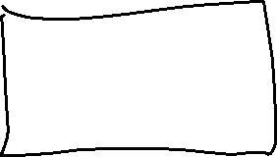


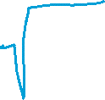

















Slide 5































Slide 6




















Slide 7












Slide 8




















Slide 9









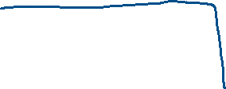



















Slide 10














Slide 11











Slide 12

























Slide 13


























Slide 14


















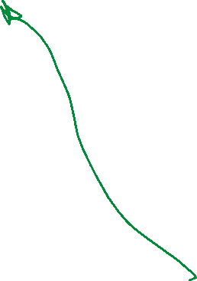












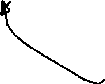








Slide 15
























Slide 16
























