Slide 1
Plasma 18
Chen 4.7 Goodness of plasma approximation
Chen 4.8 Comparison of electron and ion waves

Slide 2




























Slide 3




























Slide 4









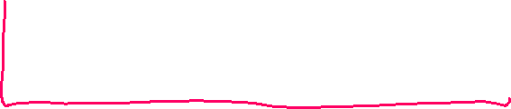







Slide 5


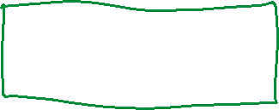
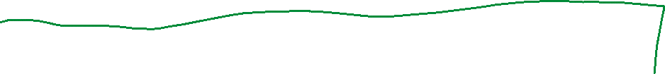











Slide 6













Slide 7





























Slide 8
























Slide 9





























Slide 10



Slide 11

Fig. 4.14 Q-machine experiment to detect ion waves. [From N. Rynn and N. D’Angelo, Rev. Sci.
Instrum. 31, 1326 (1960).]

Slide 12








Fig. 4.15 Oscillograms of
signals from the driver and
receiver grids, separated by
a distance d, showing the
delay indicative of a
traveling wave. [From A. Y.
Wong, R. W. Motley, and
N. D’Angelo, Phys. Rev.
133, A436 (1964).]

Slide 13





















Fig. 4.16 Experimental measurements of delay vs. probe separation at various frequencies of the
wave exciter. The slope of the lines gives the phase velocity. [From Wong, Motley, and D’Angelo,
loc. cit.]

Slide 14






Fig. 4.17 Measured phase velocity of ion waves in potassium and cesium plasmas as a function of
frequency. The different sets of points correspond to different plasma densities. [From Wong,
Motley, and D’Angelo, loc. cit.]

