Slide 1
Plasma 19
Chen 4.9 Electrostatic electron oscillations perpendicular to B.

Slide 2
































Slide 3
























Slide 4
























Slide 5
























Slide 6








Slide 7






















Slide 8












Slide 9






















Slide 10















Fig. 4.19 Motion of
electrons in an upper hybrid
oscillation

Slide 11








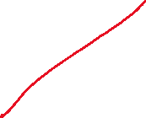








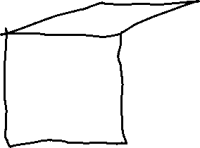

















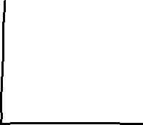











Slide 12






Fig. 4.20 Results of an
experiment to detect the
existence of the upper
hybrid frequency by
mapping the conditions
for maximum absorption
(minimum transmission)
of microwave energy sent
across a magnetic field.
The field at which this
occurs (expressed as ω2c
/ω2)
is plotted against discharge
current (proportional to
plasma density). [From
R. S. Harp, Proceedings
of the Seventh International
Conference on Phenomena
in Ionized Gases, Belgrade,
1965, II, 294 (1966).]

Slide 13































Slide 14








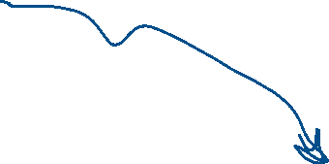












Fig. 4.21 The Trivelpiece–
Gould dispersion curves for
electrostatic electron waves
in a conducting cylinder
filled with a uniform plasma
and a coaxial magnetic
field. [From A. W.
Trivelpiece and R. W.
Gould, J. Appl. Phys. 30,
1784 (1959).]

Slide 15



Fig. 4.22 Experimental
verification of the
Trivelpiece –Gould curves,
showing the existence of
backward waves; that is,
waves whose group
velocity, as indicated by the
slope of the dispersion
curve, is opposite in
direction to the phase
velocity. [From Trivelpiece
and Gould, loc. cit.]

