Slide 1
Plasma 20
4.10 Electrostatic Ion Waves Perpendicular to B

Slide 2























Slide 3





































Slide 4








































Slide 5









































Slide 6

















Slide 7

















Slide 8

















Slide 9









Slide 10






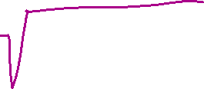












Slide 11















































Slide 12



















































Slide 13












Fig. 4.24 Schematic of a Q-machine experiment on electrostatic ion cyclotron waves.
[After R. W. Motley and N. D’Angelo, Phys. Fluids 6, 296 (1963).]

