Slide 1
Plasma 21
4.11 The Lower Hybrid Frequency
4.12 Electromagnetic Waves with B₀=0
4.13 Experimental applications

Slide 2
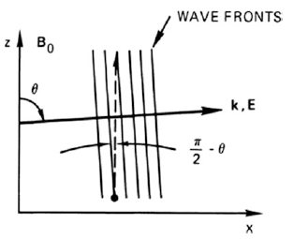




















Slide 3






































Slide 4






















Slide 5
















Slide 6




























Slide 7















4.12 Electromagnetic Waves with B₀=0

Slide 8




Slide 9



















Slide 10







Slide 11























Slide 12



















Slide 13












Slide 14


















Fig. 4.26 Dispersion
relation for electromagnetic
waves in a plasma with no
dc magnetic field

Slide 15


























Slide 16

















Slide 17










































Slide 18
















Slide 19










Slide 20


























Fig. 4.31 A plasma confined in a long, linear solenoid will trap the CO2 laser light used to heat it
only if the plasma has a density minimum on axis. The vacuum chamber has been omitted for
clarity

Slide 21

























