Slide 1
Plasma 22
Chen 4.14 EM waves perpendicular to B₀.
4.15 Cutoffs and Resonances

Slide 2
































Slide 3















Fig. 4.34 An ordinary
wave launched from a
waveguide antenna toward
a magnetized plasma
column

Slide 4






















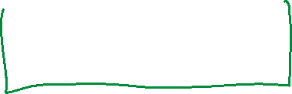




Slide 5




























Fig. 4.35 The E-vector of
an extraordinary wave is
elliptically polarized. The
components Ex and Ey
oscillate 90 out of phase,
so that the total electric field
vector E1 has a tip that
moves in an ellipse once in
each wave period

Slide 6













Slide 7















Slide 8











Slide 9







Slide 10















Slide 11



































Slide 12












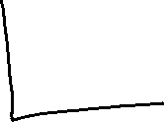






















Slide 13



















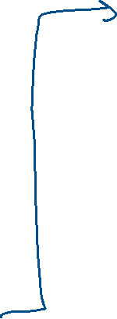




Slide 14




























Slide 15









Fig. 4.36 The dispersion of the extraordinary wave, as seen from the behavior of the phase
velocity with frequency. The wave does not propagate in the shaded regions

Slide 16























Slide 17




