Slide 1
Plasma 23
4.16. Electromagnetic waves parallel to B0.
4.17.1 The Whistler Mode
4.17.2 Faraday rotation

Slide 2

















Slide 3









Slide 4












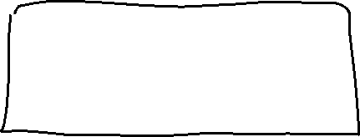


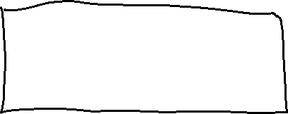






Slide 5
Fig. 4.38 Geometry of
right- and left-handed
circularly polarized waves
propagating along B0

Slide 6


























Slide 7







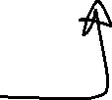

















Slide 8












Slide 9
























Fig. 4.40 Actual spectrograms of whistler signals, showing the curvature caused by the
low-frequency branch of the R-wave dispersion relation (Fig. 4.39). At each time t, the receiver
rapidly scans the frequency range between 0 and 20 kHz, tracing a vertical line. The recorder
makes a spot whose darkness is proportional to the intensity of the signal at each frequency. The
downward motion of the dark spot with time then indicates a descending glide tone. [Courtesy of
D. L. Carpenter, J. Geophys. Res. 71, 693 (1966).]

Slide 10
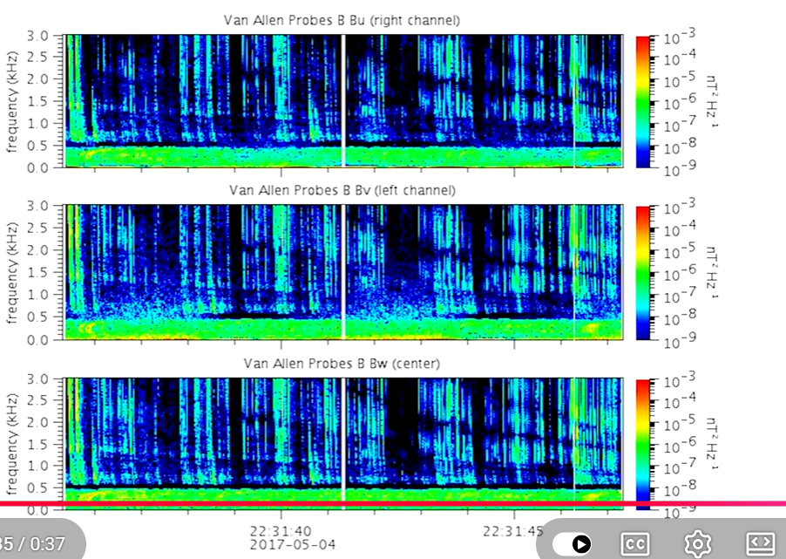
On May 4, 2017, NASA’s Van Allen Probes recorded these whistler waves in space above Earth. Waves like these are created by lightening discharges in Earth’s atmosphere. The signals bounce back and forth along Earth’s magnetic field lines, creating the unique whistling tone. This video shows the data from Electric and Magnetic Field Instrument Suite and Integrated Science, the instrument aboard the Van Allen Probes that recorded the sounds. A range of frequencies are shown low to high along the vertical axis and the strength of the signal at each frequency and time are color coded — blue being weak and red being strong.
https://www.youtube.com/watch?v=lZ5ZvVZ4jWk

Slide 11
https://www.youtube.com/watch?v=9vGTtxc4Iw0
Whistler modes are only one of the kinds of audio frequency waves in Earth’s plasma sphere. https://www.youtube.com/watch?v=oGYv3sCuxVQ
Other planets make different sounds
https://www.youtube.com/watch?v=Y295gW-D3sc

Slide 12
Fig. 4.42 Faraday rotation
of the plane of polarization
of an electromagnetic wave
traveling along B0
Fig. 4.43 A plane-polarized wave as the sum of left and righthanded circularly polarized waves

Slide 13



























Fig. 4.44 After traversing the plasma, the L wave is advanced in phase relative to the R wave, and
the plane of polarization is rotated

Slide 14























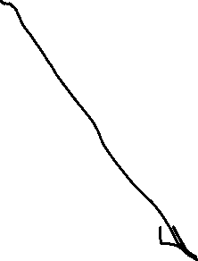


Slide 15













































Slide 16

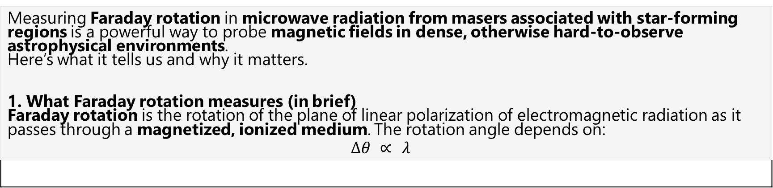
Measuring Faraday rotation in microwave radiation from masers associated with star‑forming regions is a powerful way to probe magnetic fields in dense, otherwise hard‑to‑observe astrophysical environments. Here’s what it tells us and why it matters. 1. What Faraday rotation measures (in brief) Faraday rotation is the rotation of the plane of linear polarization of electromagnetic radiation as it passes through a magnetized, ionized medium. The rotation angle depends on: $$Δθ ∝ λ^{}$$
So a Faraday rotation measurement gives you the line‑of‑sight magnetic field weighted by electron density.

Slide 17
Astrophysical masers (e.g., OH, H₂O, or CH₃OH masers) formed in star‑forming regions have key advantages: Very bright (high signal‑to‑noise) Extremely narrow spectral lines Highly polarized (both linear and circular) Originate in compact, localized regions (AU–sub‑AU scales) These properties let astronomers measure small Faraday rotations with high precision and associate them with specific physical structures in star formation.
a) Magnetic field strength and direction Faraday rotation gives the sign and magnitude of the line‑of‑sight magnetic field in or around the maser region. This complements: Zeeman splitting → total field strength at the maser site Dust polarization → plane‑of‑sky magnetic field Together, they allow partial reconstruction of the 3D magnetic field geometry.
From maser Faraday rotation measurements, astronomers can infer whether magnetic fields are: Ordered vs. turbulent Aligned with: Protostellar disks Bipolar outflows Filamentary molecular clouds This tells us whether magnetic fields: Guide gas collapse Regulate angular momentum Collimate outflows and jets

Slide 18
(c) Role of magnetic fields in star formation physics The results directly inform questions such as: Are star‑forming clouds magnetically dominated or gravity‑dominated? Do magnetic fields slow or control collapse? How efficiently do they remove angular momentum from infalling gas? Masers probe high‑density regions (n ≳ 10⁶–10⁹ cm⁻³) that most other techniques cannot. (d) Conditions in ionized gas along the line of sight Because Faraday rotation depends on electron density as well as magnetic field, it can distinguish between: Rotation occurring within the maser environment itself Rotation caused by foreground ionized gas (H II regions, ionized envelopes) This helps disentangle local vs. global magnetic structures. (e) Evolutionary stage of star formation Different maser species appear at different evolutionary stages: OH masers → early massive star formation CH₃OH masers → deeply embedded protostars H₂O masers → outflows and shocks Faraday rotation measurements across these species reveal how magnetic fields evolve as stars form.

