Slide 1
Plasma 25
4.19 Magnetosonic waves
4.20 Summary of Elementary Plasma Waves
4.21 The CMA diagram

Slide 3






Slide 4

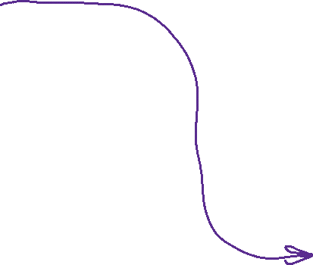






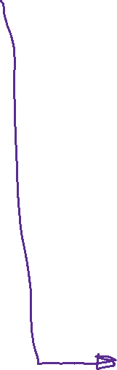



Slide 5










Slide 6








Slide 7



Slide 9
















Slide 10









Slide 11






Slide 14




Slide 15





