Slide 1
Plasma 26
5.1 Diffusion and Mobility in Weakly Ionized Gasses
5.1.1 Collision Parameters
5.1.2 Diffusion Parameters

Slide 2















































Slide 3























Slide 4



Fig. 5.1 Diffusion of gas
atoms by random collisions

Slide 5
























Slide 6

































Slide 7













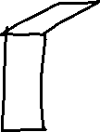











Slide 8
































Slide 9









































Slide 10






















Slide 11







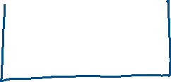











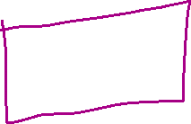


Slide 12















Slide 13

































