Slide 1
Plasma 27
5.2. Decay of Plasma by Diffusion
5.2.1 Ambipolar diffusion
5.2.2 Diffusion in a slab

Slide 2










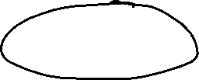













Slide 3






























Slide 4








































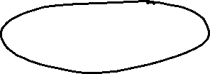







Slide 5











Slide 6

























Slide 7


























Slide 8























Slide 9























Slide 10
































Slide 11



















Slide 12



























Slide 13






























Slide 14






























Fig. 5.4 Decay of an
initially nonuniform
plasma, showing the rapid
disappearance of the higherorder
diffusion modes

Slide 15

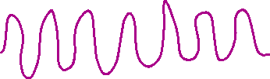































Slide 16































Slide 17














Slide 18















Slide 19
































Fig. 5.5 Motion of a plasma slab in rectilinear and cylindrical geometry, illustrating the difference
between a cosine and a Bessel function
Fig. 5.6 The Bessel
function of order zero

Slide 20



























