Slide 1
Plasma 31
5.6 Collisions in Fully Ionized Plasmas
5.6.1 Plasma resistivity

Slide 2






















Fig. 5.16 Shift of guiding
centers of two like particles
making a 90 collision

Slide 3































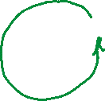











Slide 4
































Slide 5





















Fig. 5.17 Shift of guiding
centers of two oppositely
charged particles making a
180 collision

Slide 6
























Slide 7



















Slide 8




























































Slide 9
































Slide 10

























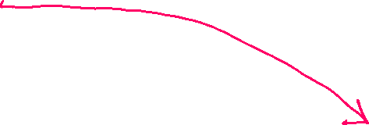



Slide 11























Fig. 5.18 Orbit of an electron making a Coulomb collision with an ion

Slide 12



Slide 13














Slide 14









Slide 15



















Slide 16










































Slide 17






































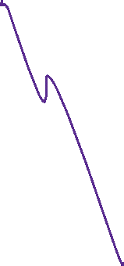



Slide 18


















Slide 19
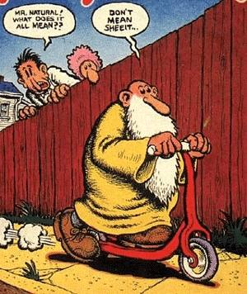

Slide 23


























Slide 24

























Slide 25
























Slide 26


















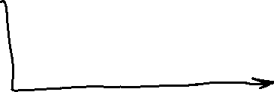







Slide 27













































