Slide 1
Plasma 32
5.7 Single-fluid MHD equations
5.8 Diffusion of fully ionized plasmas

Slide 2




































Slide 3


















Slide 4
















Slide 5































Slide 6
































Slide 7







































Slide 8














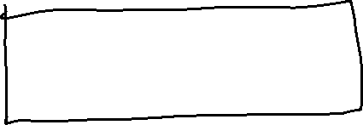



Slide 9












Slide 10


















Slide 11



























Slide 12















Slide 13




















Slide 14














Slide 15
















Slide 16





































Slide 17














