Slide 1
Plasma 33
5.9 Solutions of the Diffusion Equation

Slide 2














































Slide 3














Slide 4















Slide 5


























Slide 6














Slide 7





























Slide 8















Slide 9




























Slide 10





















































Slide 11







Slide 12


Slide 13




Slide 14
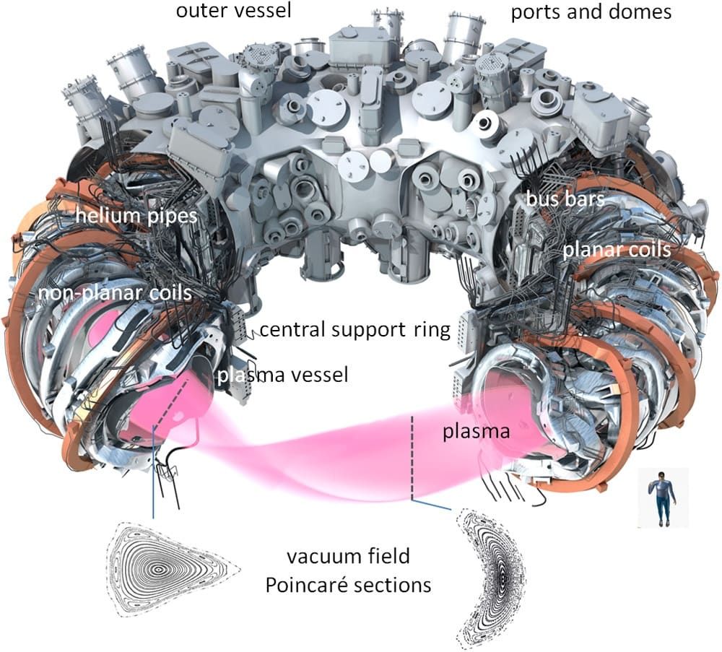
https://www.youtube.com/watch?v=vgDGPZEFV80
A stellarator is a nuclear fusion device that uses complex, external magnetic coils to twist and confine plasma, aiming to generate clean energy. Invented by Lyman Spitzer in 1951, they differ from tokamaks by operating continuously without requiring a large current through the plasma, making them inherently stable.

Slide 15
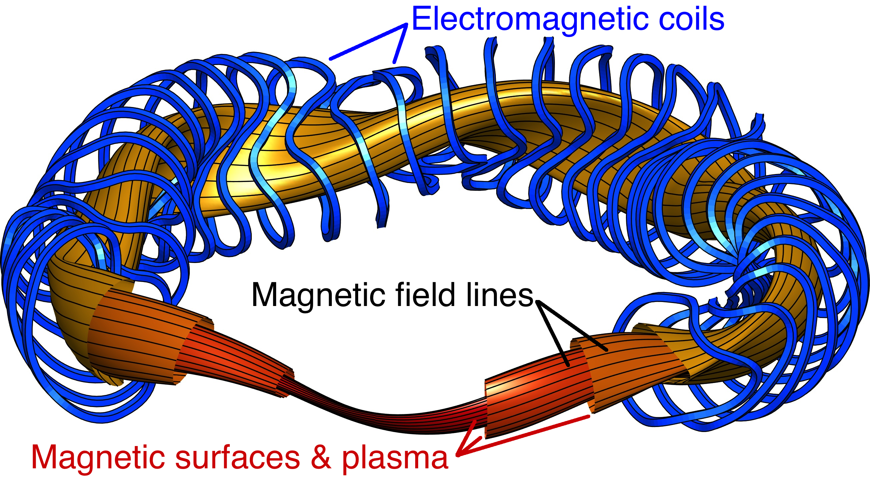

Slide 16
Fig. 5.20 Summary of confinement time measurements taken on various types of discharges in
the Model C Stellarator, showing adherence to the Bohm diffusion law (Courtesy of D. J. Grove,
Princeton University Plasma Physics Laboratory, sponsored by the U.S. Atomic Energy
Commission)

Slide 18





Slide 20



Slide 21
Fig. 5.21 A banana orbit of a particle confined in the twisted magnetic field of a toroidal
confinement device. The “orbit” is really the locus of points at which the particle crosses the
plane of the paper

Slide 22
Fig. 5.22 Behavior of the
neoclassical diffusion
coefficient with collision
frequency ν

