Slide 1



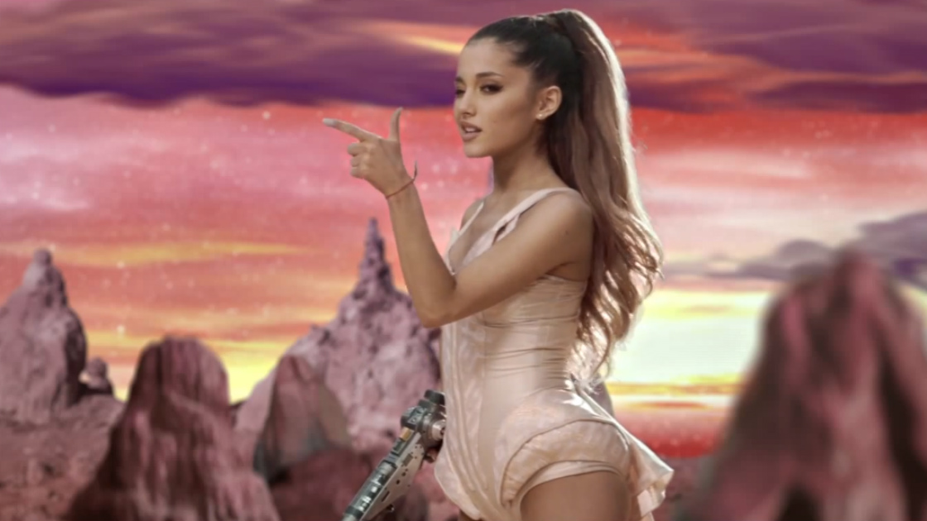
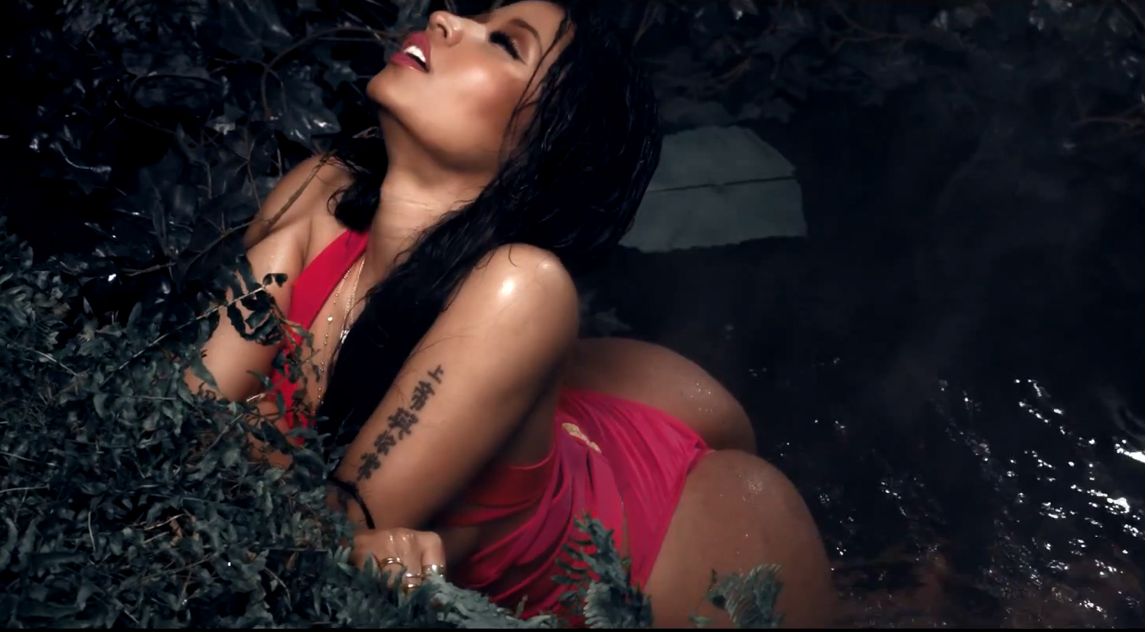
SEXUAL CONTENT IN MUSIC’S RELATIONSHIP WITH CONSUMERS’ BODY IMAGE,
SEXUALIZATION AND OBJECTIFICATION
Marika Gilbert
Mentor: Chrysalis Wright
University of Central Florida
Background
Studies have demonstrated that music media can have an effect on how its consumers view themselves and their body, as well as how they behave. Moreover, both song lyrics and music videos can be objectifying and detrimental when those images are relayed back onto its consumers. The main genres which promote themes of power, sexism, and violence tend to be pop, rap, and hip-hop (Bretthauer, Zimmerman, & Banning, 2007).
Many pop, R&B, and rap songs contain demeaning messages of men in power over women, sex as a top priority for men, the objectification of women, sexual violence against women, women being defined by having a man, and women as not valuing themselves (Aubrey & Frisby, 2011; Frisby & Aubrey, 2012; Mischner, et al., 2013; Wallis, 2011). This can send the message that women exist as sexual objects whose value depends on their physical appearance (Mischner, et al., 2013). A study conducted by Vandenbosch and Eggermont (2012) showed a significant relationship between consuming sexually objectifying media, internalization, self-objectification, and body surveillance. Mischner and colleagues (2013) found that girls with high objectifying media exposure are more likely to be dissatisfied with their body image and be more pressured to form their bodies into the “perfect” image. This can even lead women to dislike other women, even close friends who have a perceived nicer body image (Lara, 2009).
The purpose of the current study was to examine the relationship between sexual content in pop, rap, and R&B music videos, and female consumers’ body image, self-objectification, objectification of other women, and self-esteem.
Results
Intercorrelations were conducted between the study variables. Results can be found in Table 1. There was some correlation among participants demographic variables, objectification variables, and music video content.
Linear regression analyses were conducted to determine the relationship between participants’ demographics and exposure to sexual content in music videos to objectification of other women, objectified body consciousness, and self-objectification. The overall model for self-objectification was significant model, F (9, 298) = 2.10, p = .03, R²= .06. However, results were not significant for objectification of other women and objectified body consciousness. See Table 2 for results.
The Test of Joint Significance was conducted to test the hypothesis that female body image and self-objectification mediate the relationship between exposure to sexual content in music videos and self-esteem. The first set of analyses regressed exposure to sexual content in music videos on participant body image and self-objectification (See Table 3). The second analysis regressed body image and self-objectification on participant self-esteem (see Table 4). The overall model was significant, F (2, 305) = 28.81, p < .001, R ² = .16.
“
Discussion
Method
Participants:
Three hundred and eight female college students participated. The majority of participants were White (48.7%, n = 150). The average age of participants was 21.02 years (SD = 5.32). The majority of participants identified as middle-class (39.0%, n = 120) or upper middle-class (30.8%, n = 95).
Measures:
Demographic Questionnaire. Participants answered questions regarding their age, ethnicity, social class, and gender.
Objectification Questionnaires. Participants completed a series of questionnaires that were used to assess objectified body consciousness (Greenleaf & McGreer, 2006; McKinley & Hyde, 1996), self-objectification (Fredrickson et al., 1998), and objectification of other women (Noll & Fredrickson, 1998; Strahan et al., 2008).
Self-Esteem Scale. Participants completed the Rosenberg ten item self-esteem scale, with five being reversed scored, to assess self-esteem (Rosenberg, 1965).
Sexual Content in Music Videos. Participants rated the top 53 music artists from the top-40 charts on how much they liked the artist as well as how much they watch the artists’ music videos. Exposure to sexual content in music videos was based on measures of content analysis using the frequency method for the most current popular songs performed by music artists by participants using two independent raters. Songs from each artist were selected from the top- 40 charts that had been given air play on radio stations and music television. Artists not rated highly by participants or who did not have a music video available for their most current popular songs were not analyzed in the current study. Of the 53 music artists, only 20 had an “official” video for their current popular songs. Based on participant ratings, 11 artists representing rap, pop, and R&B were used in analyses for this study. Exposure variables for each music genre were created for exposure to sexual references via music videos by multiplying self-reported viewing habits of each of the top rated artists by the average content contained in music videos. The total exposure variables for music videos were used in analysis.
The results of this study indicated that there is a negative association between R&B music and objectification of other women. In addition, results showed that rap music is associated with objectified body consciousness. Results also indicated that exposure to sexual content in music videos is related to self-objectification. Results were supported by previous research that found similar results in terms of exposure to sexual content in music videos and body image, self-objectification, and the objectification of other women (Gordon, 2008; Vandenbosch & Eggermont, 2012).
One limitation of the study was its lack of generalizability due to limited location, race, and age of the sample size. Additionally, results of the current study only partially supported the main hypotheses and some results may be limited or otherwise difficult to interpret. Additionally, predictor variables were not found to be significant even though the overall model was significant (see Table 2). This may have occurred because too many predictor variables were entered in the model, which can mask the significant predictors. It could also be that the predictor variables were correlated with one another, impeding the regression analysis results (Chatterjee, Hadi, & Price, 2000).
Future research should focus on exposure effects from the top artists that display sexual content in their music videos, instead of top artists in general. Moreover, future research should widen the age range of female participants to include young adolescent girls as well as adult women. Also, future research should be done on males and their sexualization and objectification. Body image of adolescent boys is often overlooked in research, but it is just as important to examine how media affects boys in relation to their body image and self-esteem.
Pop
Katy Perry
Lana del Rey
Miley Cyrus
Maroon 5
Ariana Grande
Rap
J. Cole
Nicki Minaj
Will.i.am
Drake
R&B
Justin Timberlake
Bruno Mars

